Slide 1
Applications of confidence intervals

Slide 2

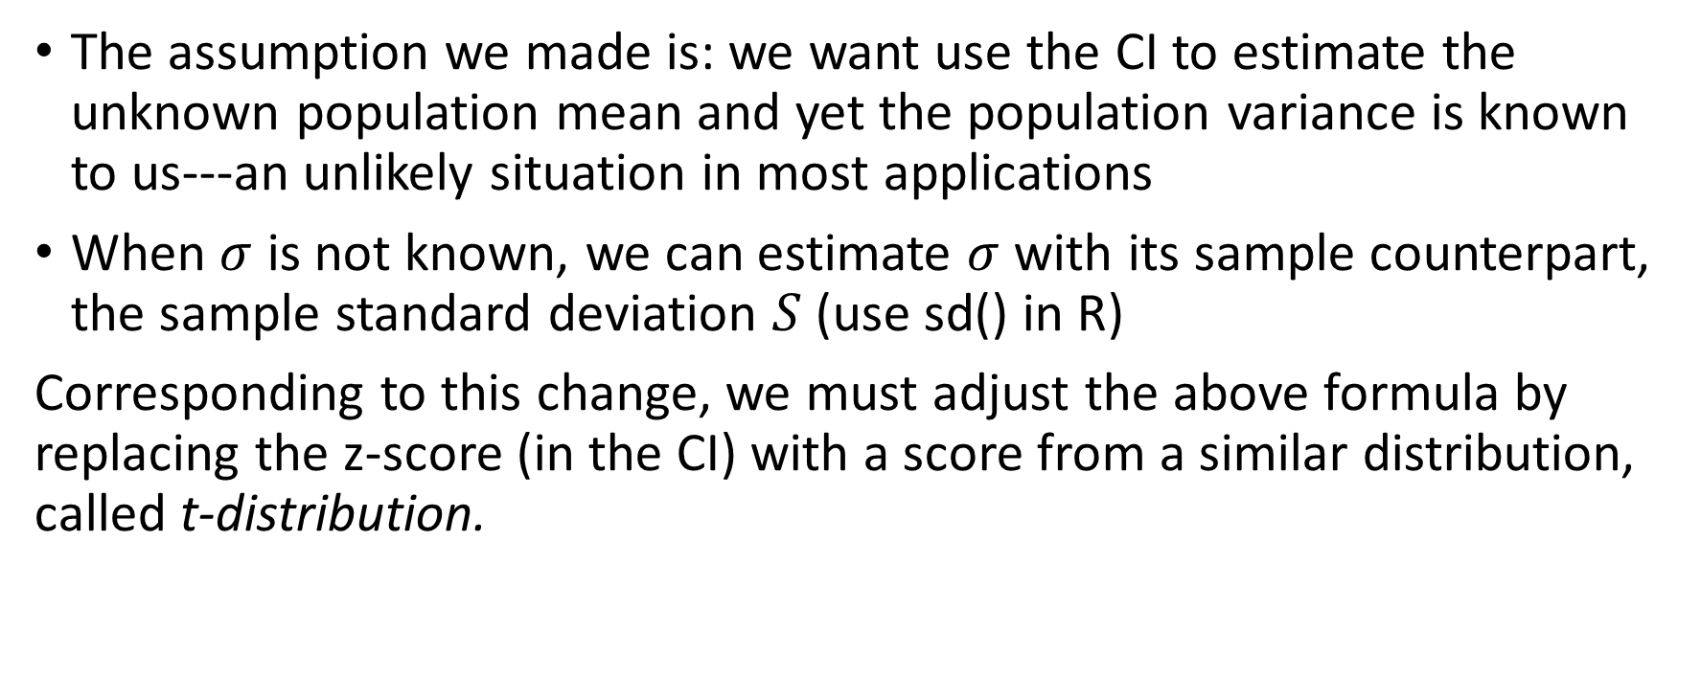
The p% CI is [$\overline{X_{n}}−z_{p′}∗\frac{σ}{\sqrt{n}}$, $\overline{X_{n}}+z_{p′}∗\frac{σ}{\sqrt{n}}$], where $z_{p′}$ is the standardized Z score and p’=p+(100-p)/2 (%))
The assumption we made is: we want use the CI to estimate the unknown population mean and yet the population variance is known to us---an unlikely situation in most applications
When $σ$ is not known, we can estimate $σ$ with its sample counterpart, the sample standard deviation $S$ (use sd() in R)
Corresponding to this change, we must adjust the above formula by replacing the z-score (in the CI) with a score from a similar distribution, called t-distribution.

Slide 3
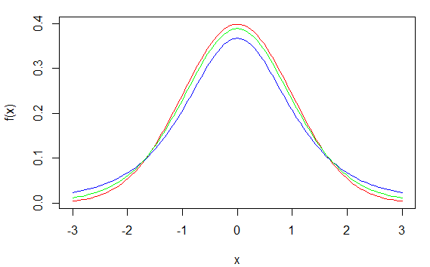
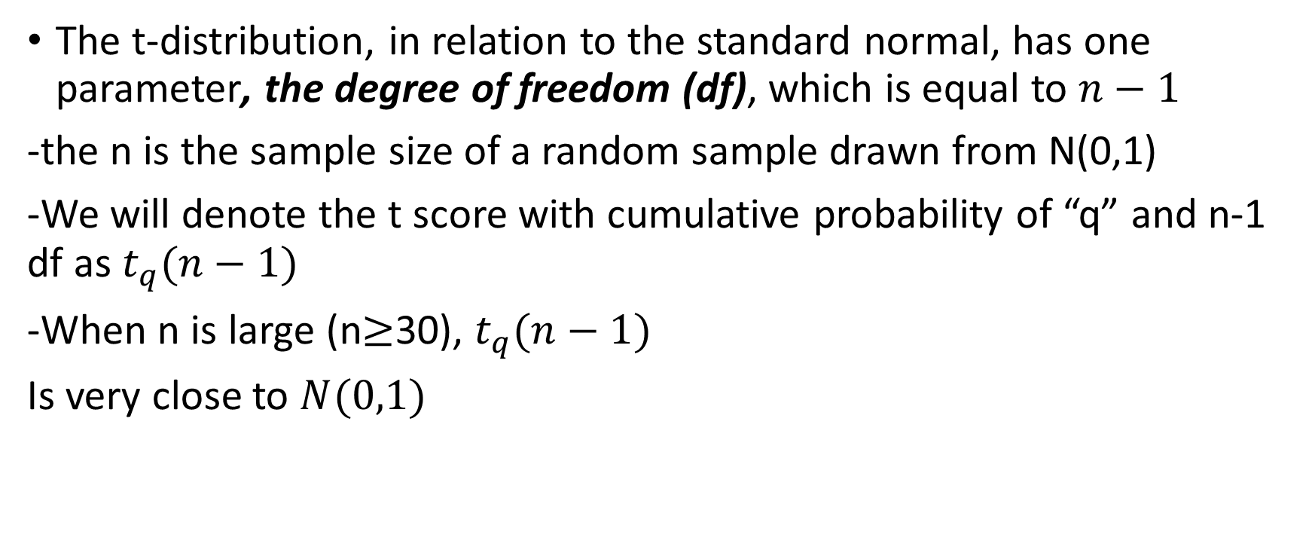


t-distribution
The t-distribution, in relation to the standard normal, has one parameter, the degree of freedom (df), which is equal to $n−1$
-the n is the sample size of a random sample drawn from N(0,1)
-We will denote the t score with cumulative probability of “q” and n-1 df as$t_{q}(n−1)$
-When n is large (n$≥$30), $t_{q}(n−1)$
Is very close to $N(0,1)$
N(0,1)
$$t(3)$$
$$t(5)$$

Slide 4
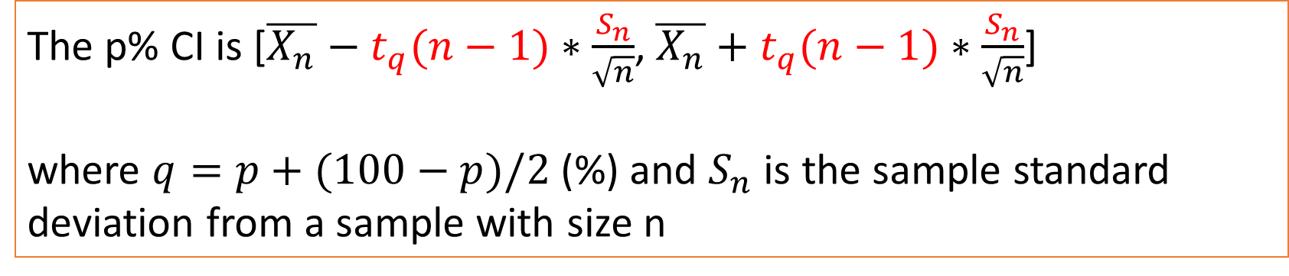
The CI when the population variance is not known
The p% CI is [$\overline{X_{n}}−t_{q}(n−1)∗\frac{S_{n}}{\sqrt{n}}$, $\overline{X_{n}}+t_{q}(n−1)∗\frac{S_{n}}{\sqrt{n}}$]
where $q=p+(100−p)/2$(%) and $S_{n}$ is the sample standard deviation from a sample with size n

Slide 5
Example: weight distribution
You measure the weights (in gram) of 25 tomatoes randomly picked from a lot (CI_t_ex1.csv).
Assuming that the weight distribution is normal, construct a 95% CI for the average weight of the entire lot.

Slide 6
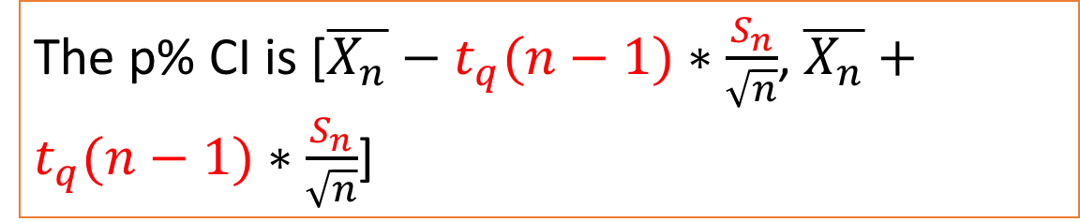
# load data
> x<-read.csv(file.choose(),header=T)
# get sample size
>n<-length(x$weight)
25
# calculate sample mean
> X_bar<-mean(x$weight)
# calculate sample standard deviation
> S<-sd(x$weight)
12.67307
# calculate lower and upper limits of CI
>LL<-X_bar-S/sqrt(n)*qt(.975,n-1)
> UL<-X_bar+S/sqrt(n)*qt(.975, n-1)
c(LL,UL)
95.00881 105.47119
The p% CI is [$\overline{X_{n}}−t_{q}(n−1)∗\frac{S_{n}}{\sqrt{n}}$, $\overline{X_{n}}+t_{q}(n−1)∗\frac{S_{n}}{\sqrt{n}}$]

Slide 7

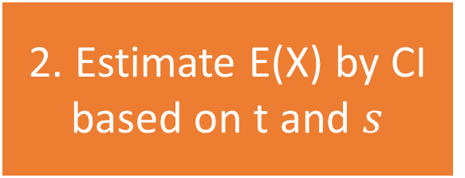
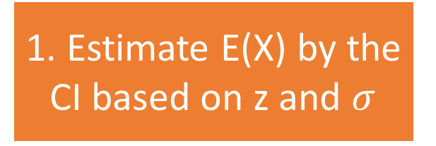
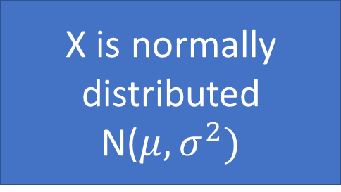

1. Estimate E(X) by the CI based on z and $σ$
If $σ$ is known
X is normally distributed N($μ,σ^{2})$
2. Estimate E(X) by CI based on t and $s$
If $σ$ is unknown

Slide 8
What if X is not normal?

Slide 9

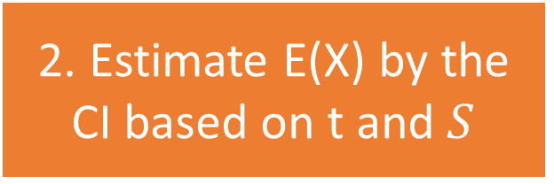
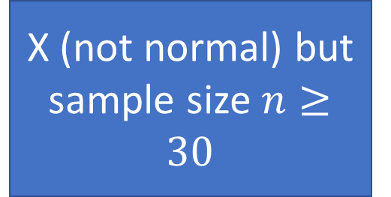
X (not normal) but sample size $n≥30$
2. Estimate E(X) by the CI based on t and $S$
By CLT, large samples make $\overline{X_{n}}$ normal
Can still use this CI formula to estimate E(X)

Slide 10
Example
CI_t_ex2.csv contains the number of calls that a call centre receive on different working days
Calculate the 95% CI for the average number of calls per day.

Slide 11
# load data
>y<-read.csv(file.choose(),header=T)
# get sample size
>n<-length(y$calls)
# calculate sample mean
>x_bar<-mean(y$calls)
# calculate lower and upper limits of CI
>LL_x<-x_bar - sd(y$calls)/sqrt(n)*qt(.975,n-1)
>UL_x<-x_bar +sd(y$calls)/sqrt(n)*qt(.975,n-1)
>c(LL_x,UL_x)
[97.63304 103.62886]

Slide 12
What if X is not normal and the sample size is small?

